Slide 1
Face Mask Detection Alert System
BugSquash 2021

Slide 2
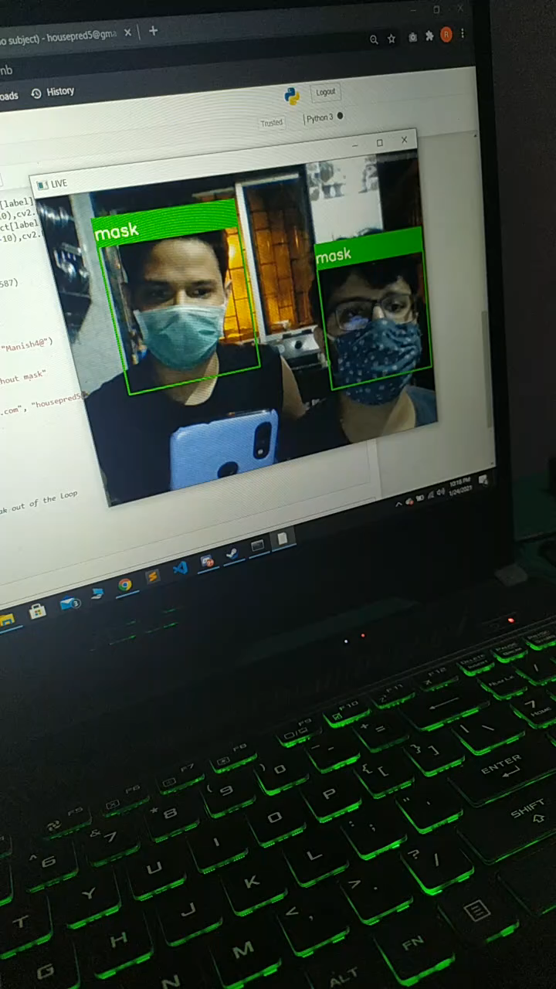
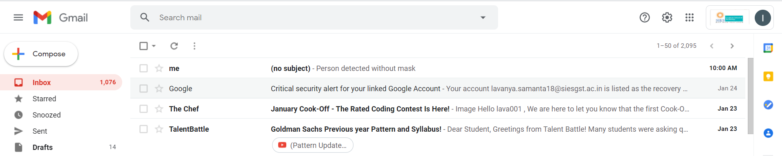
OBJECTIVES​
Detect people with or without a mask in a live feed.​
If any person is without a mask, an alert signal is sent to the concerned mail id.​

Slide 3
DEPENDENCIES
Keras Libraries
OpenCV
Python Libraries
Smtplib
Tensorflow

Slide 4


Slide 5
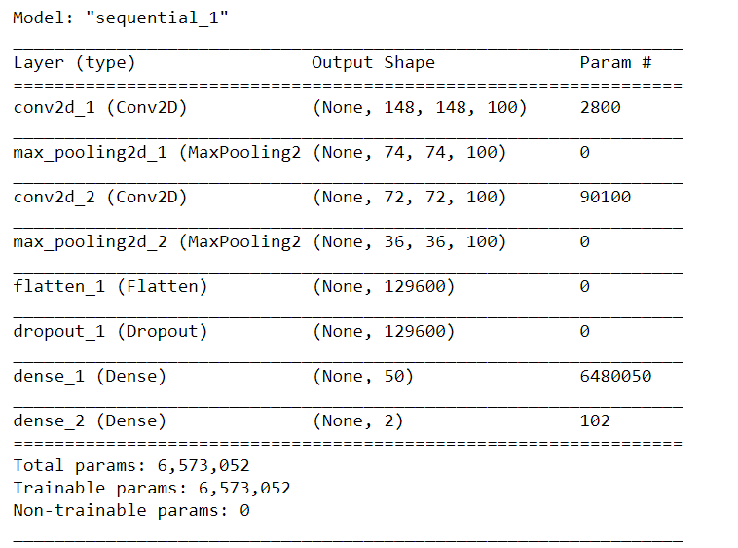
MODEL SUMMARY

Slide 6
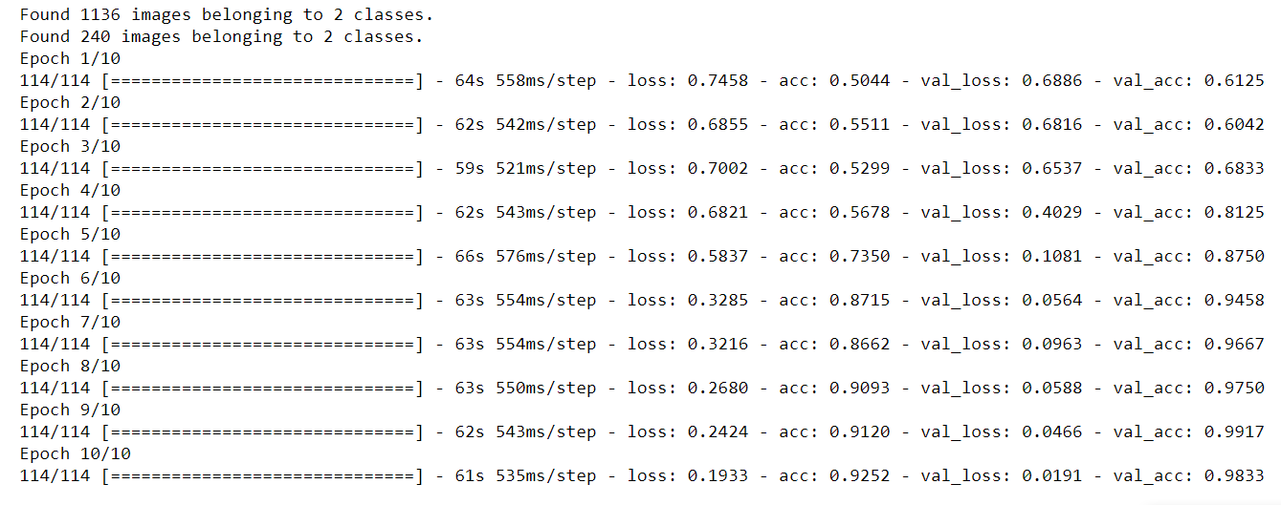
Model training

Slide 7
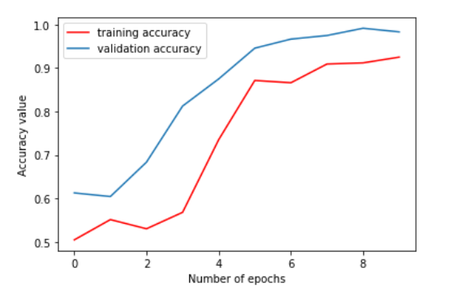
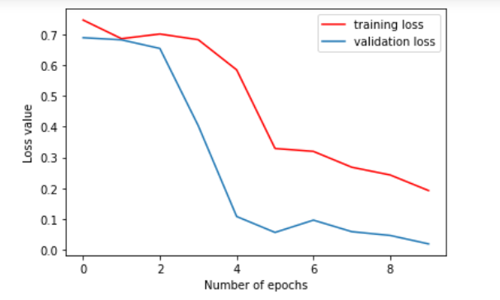
PLOTS

Slide 8
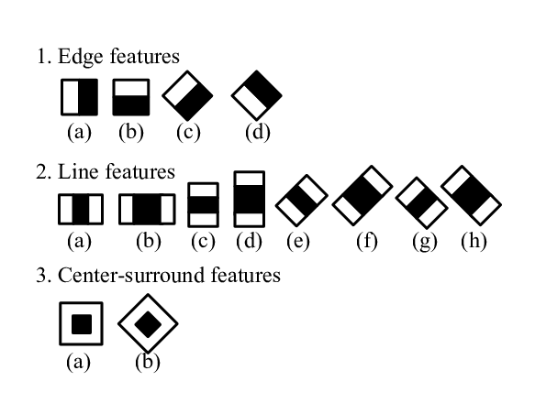
haarcascade_frontalface_default

Slide 9
THANKYOU

